Slide 1

Complex Decisions: Sequential Interactions

Slide 2

Value functions
state value function: V^{π}(s)
expected return when starting in s and following π
state-action value function: Q^{π}(s,a)
expected return when starting in s, performing a, and following π
useful for finding the optimal policy
can estimate from experience
pick the best action using Q^{π}(s,a)
Bellman equation
s
a
r
s’

Slide 3
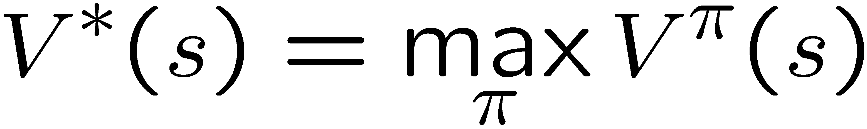
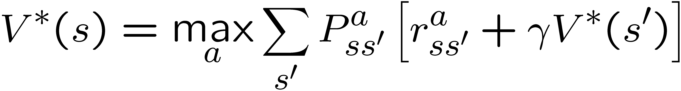
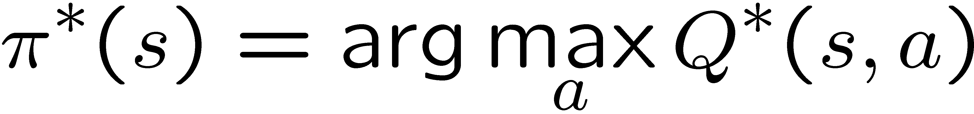
Optimal value functions
there is a set of optimal policies
V^{π} defines partial ordering on policies
the optimal value function:
Bellman optimality equation
system of n non-linear equations
solve for V*(s)
easy to extract the optimal policy
having Q*(s,a) makes it even simpler
s
a
r
s’

Slide 4
Dynamic programming
main idea
use value functions to structure the search for good policies
need a perfect model of the environment
two main components
policy evaluation: compute V^{π} from π
policy improvement: improve π based on V^{π}
start with an arbitrary policy
repeat evaluation/improvement until convergence

Slide 5
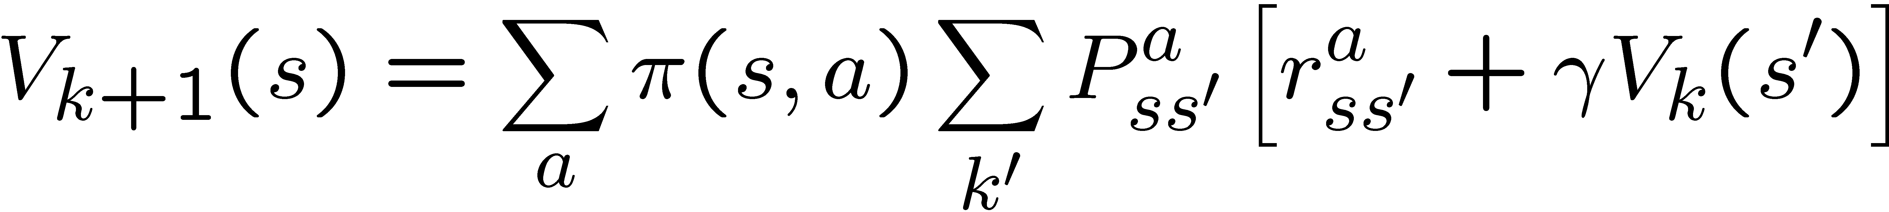
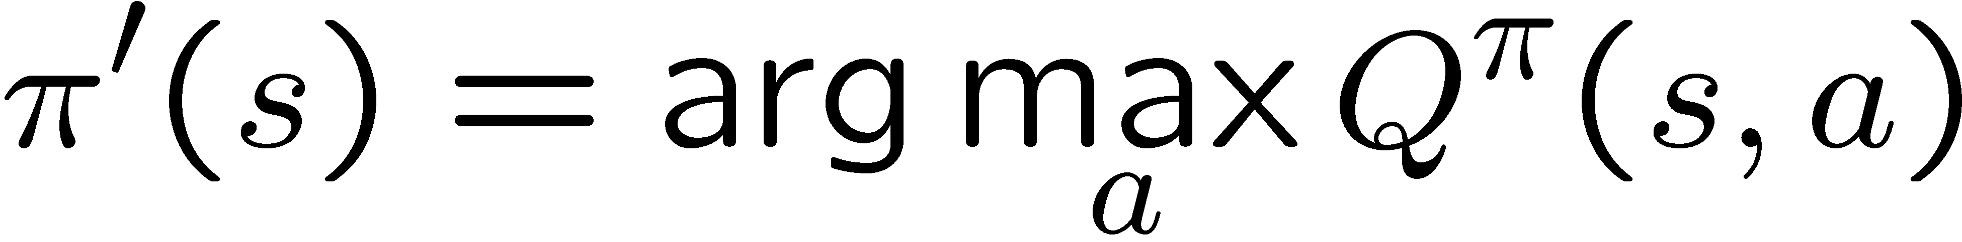
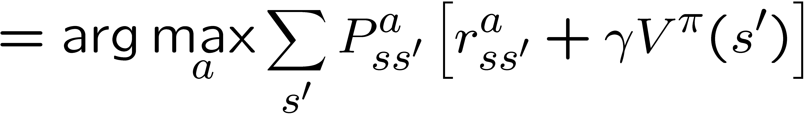
Policy evaluation/improvement
policy evaluation: π -> V^{π}
Bellman eqn’s define a system of n eqn’s
could solve, but instead use iterative version
start with an arbitrary value function V₀, iterate until V_{k} converges
policy improvement: V^{π} -> π’
π’ strictly better than π, or π’ is optimal (if π = π’)

Slide 6

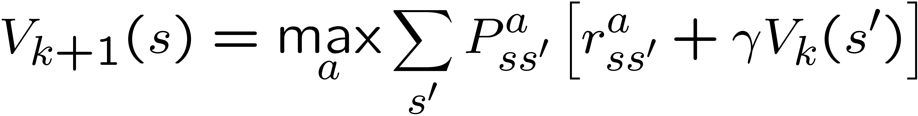
Policy/Value iteration
Policy iteration
two nested iterations; too slow
don’t need to converge to V^{πk}, just move towards it
Value iteration
use Bellman optimality equation as an update
converges to V*

Slide 7
Exercise!
Complete MDP Exercises 2 and 3

